Slide 1
Commissioner of Education’s African American History Task Force
Exemplary School District
Presented by: Dr. Donna R. Austin

Slide 2

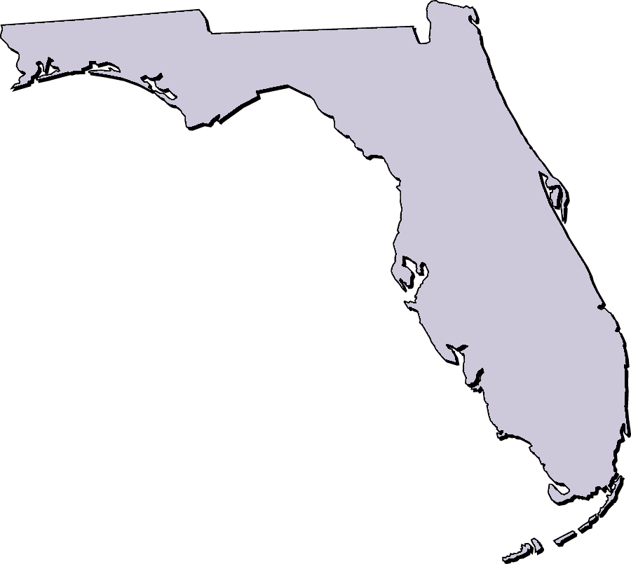
Florida African and African American History Required Instruction
Section1003.42 (2)(h) Florida Statutes
The history of African Americans, including the history of African peoples before the political conflicts that led to the development of slavery, the passage to America, the enslavement experience, abolition, and the contributions of African Americans to society. Instructional materials shall include the contributions of African Americans to American society.

Slide 3

Exemplary School District Designation
School districts providing evidence that they meet the six (6) criteria receive the Exemplary School District designation.

Slide 4
Exemplary School District Rubric

Slide 5

Criteria 1
School Board Approval of the African
American History Initiative
Objectives
The school board has developed a plan for the implementation of the Florida African and African American History required instruction.
The plan has been publicized in the school district’s curriculum guides, etc.

Slide 6

Criteria 2
Structured
Professional Development
Objectives
The school district has developed and implemented an ongoing professional development plan for training teachers, students, and school staff in strategies for teaching African American History.
Adequate resources have been allocated for structured professional development programs and for enhancing the instruction of African American History in an infused format.

Slide 7

Criteria 3
African American Studies Curriculum
Objectives
African American History Curriculum Frameworks K-12 has been integrated as part of the district’s policy with respect to required curriculum.
The curriculum has been disseminated to curriculum specialists, teachers, media specialists, and other educators in the district.
There are adequate teaching resources including books, CD’s, digital media, and lesson plans available to support this required instruction.
Hidden Figures
L to R: Dorothy Vaughan, Katherine Johnson, Mary W. Jackson, and Christine Darden are four African American female mathematicians whose complex calculations helped NASA win the Space Race.
“Those who say it can’t be done are usually interrupted by others doing it.”
– James Baldwin

Slide 8

Criteria 4
Structured Teaching of the African American History Curriculum
Objectives
African American History content appears in lesson plans over a sustained period of 180 days.
There are approved methods for teaching and assessing the African American History Curriculum.
There is African American History content infused and linked to the FSA and other high-stakes tests and requirements.
African American History content are infused in all subject areas.

Slide 9

Criteria 5
Objectives
There is university involvement in professional development, curriculum and instruction support, etc.
The school district and university partnership has sought external funding (federal grants, foundation grants, etc.)
The school district and university partnership have aided in the preparation of pre-professional teachers and other educators.
University – School
District Collaboration

Slide 10


Criteria 6
Parent/Community Partnerships
Objectives
The school district’s initiatives in African American History has resulted in the development of strategies that include the involvement of parents through awareness information sessions.
There are community partners who are involved in the development and ongoing implementation of the African American History Curriculum.

Slide 11











Exemplary School Districts
Marion County Public Schools
"Helping Every Student Succeed"
For additional information visit our website at https://afroamfl.org/ and/or contact Dr. Donna R. Austin at austin.aahtf@gmail.com

